Slide 1
Vulnerability Scanning

Slide 2
Vulnerability scanning
Vulnerability scanning is another type of scanning
Scanning of
Systems
Network component
Application

Slide 3
Vulnerability scanning
It has a database of vulnerabilities based on which it performs the check on the remote host.
Its database contains all the information required (service, port, packet type, a potential path to exploit, etc.) to check the security issue.
They can scan the network and websites against thousands of vulnerabilities, provide the list of issues based on the risk and suggest the remediation as well.

Slide 4
Features of Popular scanners
Maintain an updated database for latest vulnerabilities.
Ability to detect vulnerabilities with less false positive.
Ability to scan multiple targets simultaneously.
Ability to provide a detailed report with vulnerable request and response pair.
Recommendation to fix the vulnerabilities.
fast and can save you time

Slide 5
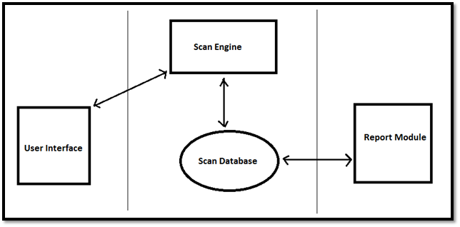
Scanner Architecture

Slide 6
Components of Scanner
1. User Interface
Interface with which user interacts to run or configure a scan.
Can be a GUI or CLI
2. Scan Engine
Execute the scan based on the installed and configured plug-ins.
3. Scan Database:
Stores the data required by the scanner
1) contain vulnerability information,
2) plug-ins, steps to mitigate the vulnerability,
3) CVE- ID mapping (Common Vulnerability and Exposures)
4) scan results, etc.
4. Report Module:
Provides the options to generate the different type of reports like
1) Detailed report,
2) Vulnerabilities List
3) Graphical report, etc.

Slide 7
Top Vulnerability scanner tools
Nessus
Nikto
OpenVAS: Open Vulnerability Assessment System (OpenVAS)
QualysGuard
Burp Suite
OWASP ZAP
Acunetix Web Vulnerability Scanner
NetSparker
Tools

Slide 8
Tool 1: Nikto

Slide 9
Nikto
Nikto scans
Dangerous files,
Outdated server software
Other problems.
Thousands of vulnerabilities
Easy to use without much instructions
Performs generic and server type specific checks.
Captures any cookies received.
Advantages
webservers for

Slide 10
Tool 2: Nessus

Slide 11
Introduction to NESSUS
Nessus
It is free of charge for personal use in a non-enterprise environment
For enterprise, 1500$/year.
used by over 75,000 organizations worldwide.
Begins by port scan with one of its four internal port scanners (or can optionally use Nmap)
To determine which ports are open on the target and then tries various exploits on them
New vulnerability checks (called plugins) on a daily basis.
Nessus developed by Tenable Network Security

Slide 12
NESSUS: Applications
Nessus scan vulnerabilities
That allow a remote hacker to control
Misconfiguration
Default passwords,
Denials of service
Finding malware
Agentless auditing
Common passwords, and blank/absent passwords
To make sure no host on your network is missing security patches
Nessus can also call Hydra (an external tool) to launch a dictionary attack.
(missing patches, etc.).
or access sensitive data on a system.
against the TCP/IP stack by using malformed packets

Slide 13
NESSUS
The user manual can be downloaded From http://static.tenable.com/documentation/nessus_6.4_user_guide.pdf
The Nessus scanner can be downloaded from http://www.tenable.com/products/nessus/select-your-operating-system

Slide 14
Nessus
What is a Plugin?
Every audit in the Tenable Nessus® vulnerability scanner is coded as a plugin: a simple program which checks for a given flaw.
Nessus uses more than 60,000+ different plugins, covering local and remote flaws.
Staying Up-to-Date?
New vulnerabilities are discovered and published every day.
As a result, staying up-to-date is a must if you want to perform a security scan. Every week, several dozens of plugins are added in the Tenable Nessus plugin feeds.

Slide 15
Procedure

Slide 16
Nessus Steps
Step 1: Creating a Scan
After Installation, you have to create a scan.
To create your scan:
In the top navigation bar, click Scans.
In the upper-right corner of the My Scans page, click the New Scan button.

Slide 17
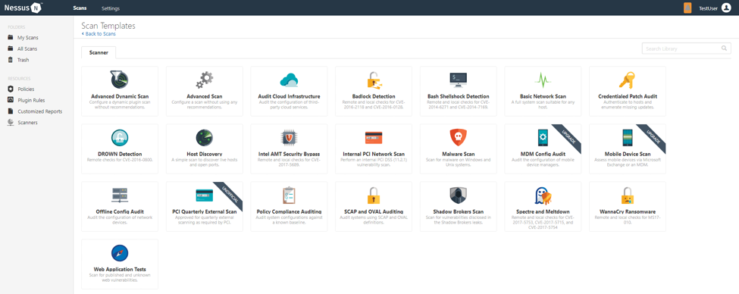
Nessus Steps
Step 2: Choose a Scan Template
refer to Scan and Policy Settings in the Nessus User Guide.

Slide 18
Nessus Steps
Step 3: Configure Scan Settings
Prepare your scan by configuring the settings available for your chosen template.
The Basic Network Scan template has several default settings preconfigured, which allows you to quickly perform your first scan and view results without a lot of effort.

Slide 19
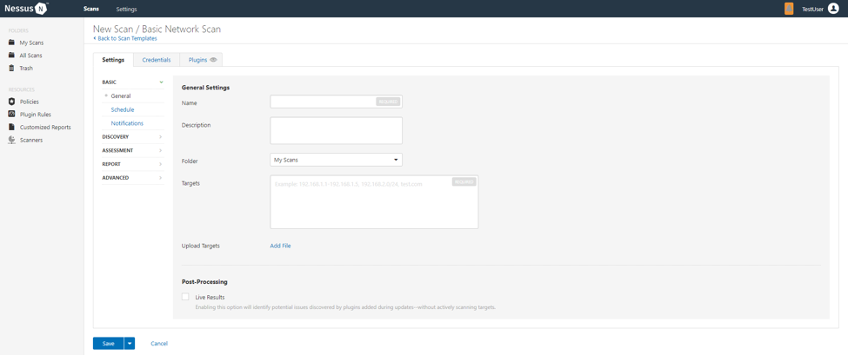
Nessus Steps
Step 3: Configure Scan Settings
1. Configure the settings in the Basic Settings section

Slide 20
Nessus Steps
Step 3: Configure Scan Settings
1. Configure the settings in the Basic Settings section
The following are Basic settings:
Setting | Description
Name | Specifies the name of the scan or policy. This value is displayed on the Nessus interface.
Description | (Optional) Specifies a description of the scan or policy.
Folder | Specifies the folder where the scan appears after being saved.
Targets | Specifies one or more targets to be scanned. If you select a target group or upload a targets file, you are not required to specify additional targets.

Slide 21
Nessus Steps
Step 3: Configure Scan Settings
2. Configure remaining settings
Although you can leave the remaining settings at their pre-configured default, Tenable recommends reviewing the Discovery, Assessment, Report and Advanced settings to ensure they are appropriate for your environment.

Slide 22
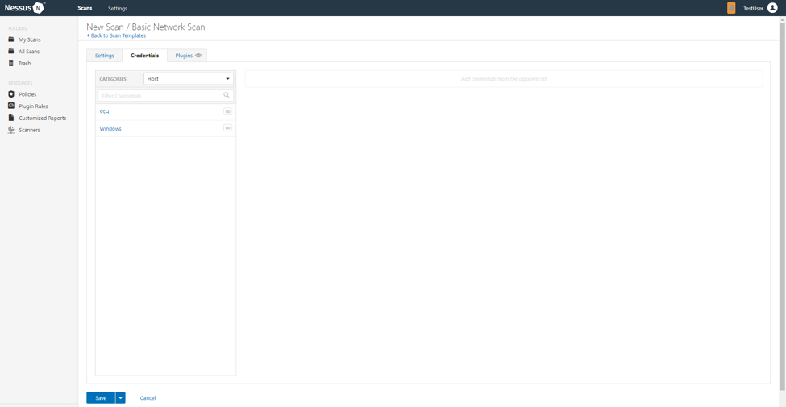
Nessus Steps
Step 3: Configure Scan Settings
3. Configure Credentials
Optionally, you can configure Credentials for a scan. This allows credentialed scans to run, which can provide much more complete results and a more thorough evaluation of the vulnerabilities in your environment.

Slide 23
Nessus Steps
Step 3: Configure Scan Settings
4. Launch Scan
After you have configured all your settings, you can either click the Save button to launch the scan later or launch the scan immediately.
If you want to launch the scan immediately, click the button, and then click Launch. Launching the scan will also save it.
The time it takes to complete a scan involves many factors, such as network speed and congestion, so the scan may take some time to run.

Slide 24
Nessus Steps
Step 4: Viewing Your Results
Viewing scan results can help you understand your organization’s security posture and vulnerabilities. Color-coded indicators and customizable viewing options allow you to tailor how you view your scan’s data.
age | Description
Hosts | Displays all scanned targets.
Vulnerabilities | List of identified vulnerabilities, sorted by severity.
Remediations | If the scan's results include remediation information, this list displays all remediation details, sorted by the number of vulnerabilities.
Notes | Displays additional information about the scan and the scan’s results.
History | Displays a list of scans: Start Time, End Time, and the Scan Statuses.

Slide 25
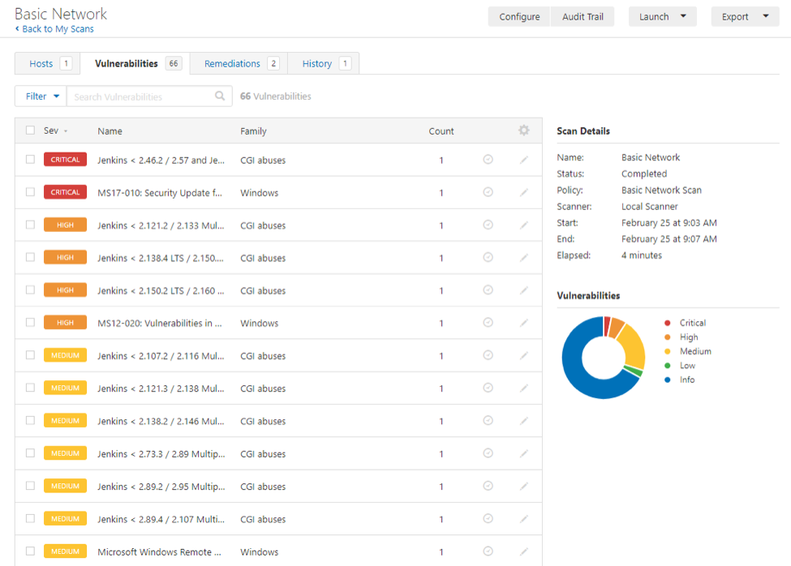
Nessus Steps
Step 4: Viewing Your Results
Viewing scan results by vulnerabilities gives you a view into potential risks on your assets.

Slide 26
Nessus Steps
Step 4: Viewing Your Results
To view vulnerabilities:
In the top navigation bar, click Scans.
Click the scan for which you want to view results.
Do one of the following:
Click a specific host to view vulnerabilities found on that host.
Click the Vulnerabilities tab to view all vulnerabilities.
(Optional) To sort the vulnerabilities, click an attribute in the table header row to sort by that attribute.
Clicking on the vulnerability row will open the vulnerability details page, displaying plugin information and output for each instance on a host.

Slide 27
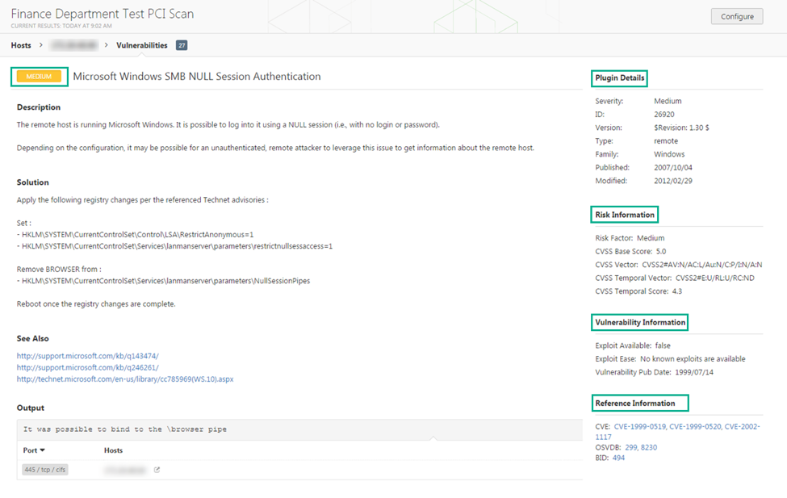
Nessus Steps
Step 4: Viewing Your Results
To view vulnerabilities:

Slide 28
Nessus Steps
Step 5: Reporting Your Results
Now you need to report your findings to your team.
Scan results can be exported in several file formats.
To Export a Scan Report:
Start from a scan's results page
In the upper-right corner, click Export.
From the drop-down box, select the format in which you want to export the scan results.
Click Export to download the report.

Slide 29
Background:
SATAN (Security Administrator Tool for Analyzing Networks) was an example of such a collection of scripts released in 1995.
Some commercialized products included:
NetSonar Vulnerability Scanner (by WheelGroup Corporation)
Internet Security Systems' (ISS) Internet Scanner
NETECT's Netective Suite
Secure Networks' Ballista Security Auditing System

Slide 30
Nmap (port scanning tool)
Nmap
Discovery of host and services
The up or down status of a host
Network services available on a host
Presence of a firewall
Operating system and version used on host
Name and version of services running on host
Command line tool: NMap
GUI tool Zenmap
Doesn't tell the existence of vulnerabilities
But able to figure out what vulnerabilities exist

Slide 31
Nessus
vulnerability scanner, Although it scans ports just like NMAP
Checks for open ports and its potential vulnerabilities.
uses plugins to determine vulnerability present on a specified machine.
Over 60,000 plugins look for vulnerabilities in Operating Systems (Unix, Linux, Windows) to specific application categories such as Databases or Web Servers.
Administrators set up policies, scans and view reports.
Policies to determine what specific vulnerabilities are scanned for.
E.g. policy to look only at database vulnerabilities and will be targeted to run against your database server(s).
E.g. policy for Windows vulnerabilities while it runs against your entire network.
Policies set what will be scanned along with how it’ll be scanned (external or internal)
Nessus is

Slide 32
In Class Exercise
Implement Nessus on website and generate report
Follow steps according to 00Ref02_Nessus on Windows
Write steps how to download and activate the Nessus (just remember it is trial version for 14 days)
Write steps and attach screenshot of each step

Slide 33
Home Exercise
Perform using tool Nikto (Ref document)
Inbuilt tool of Kali

